Slide 1
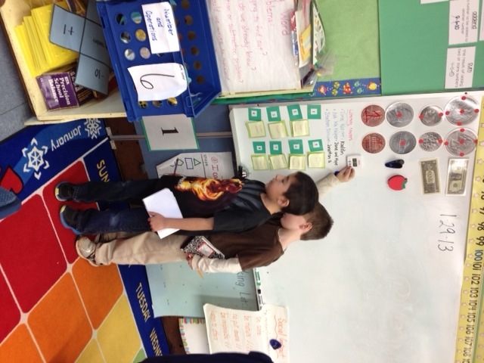

Slide 2
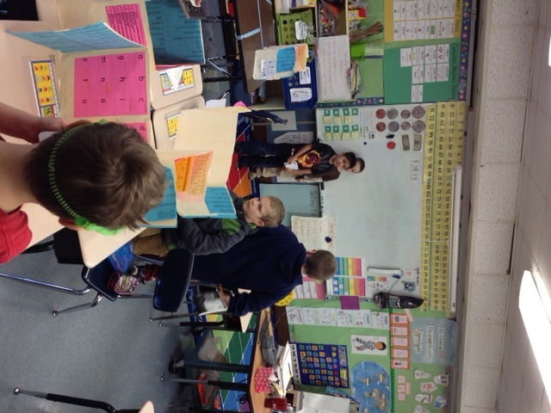

Slide 3
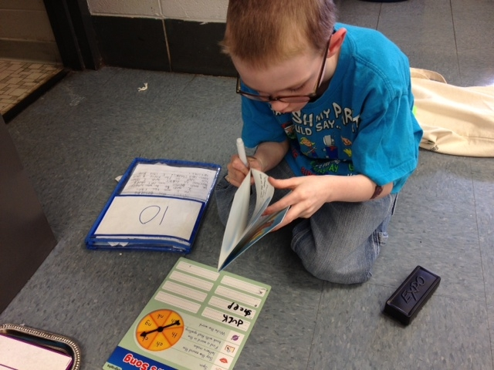

Slide 5
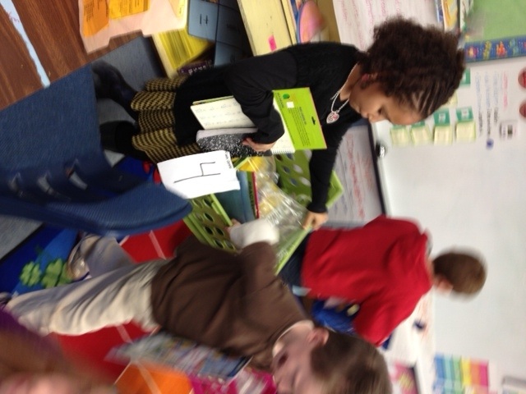

Slide 6
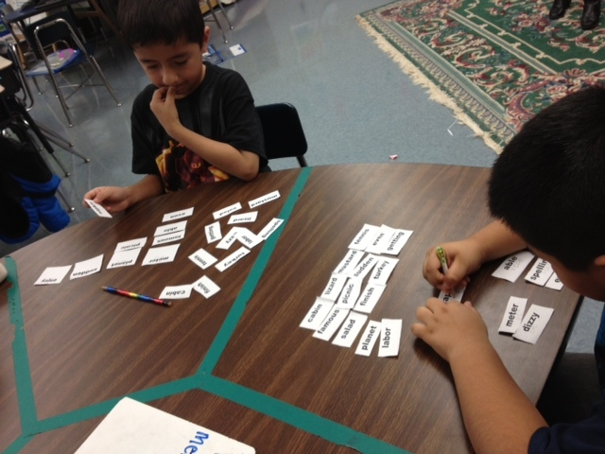

Slide 7
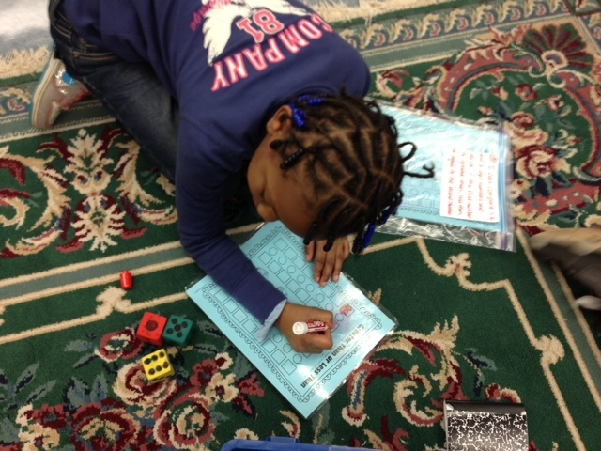

Slide 8
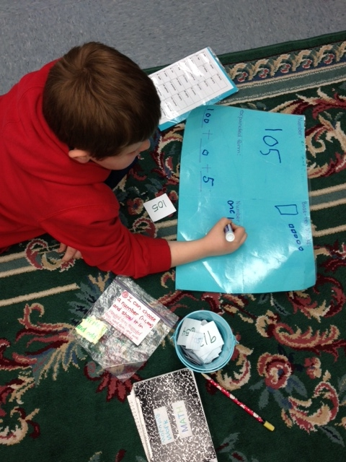

Slide 9
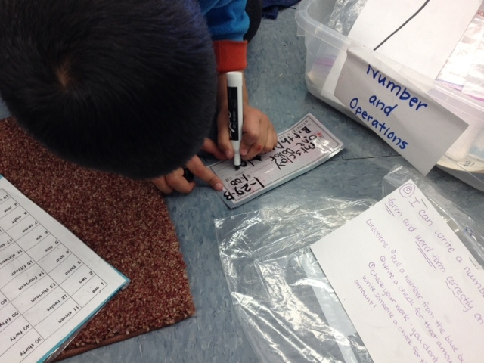

Slide 10
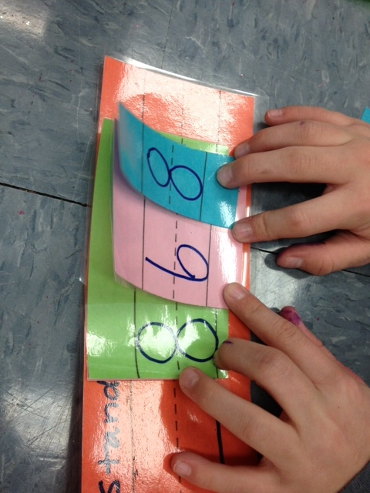

Slide 11
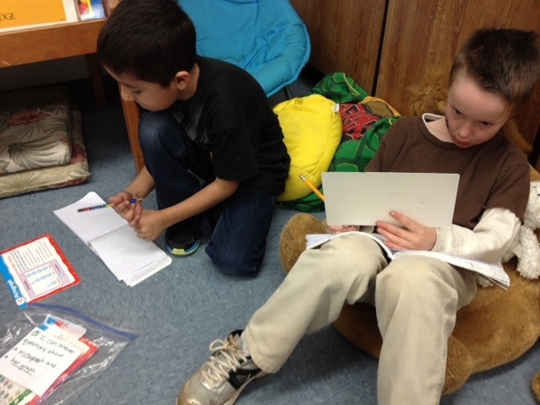

Slide 12
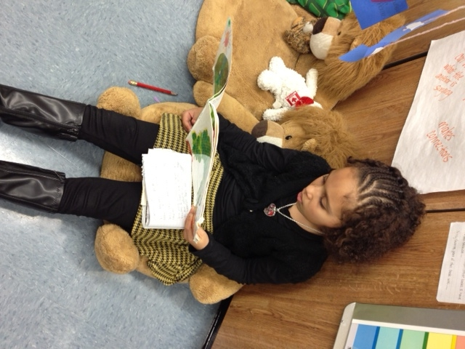

Slide 13
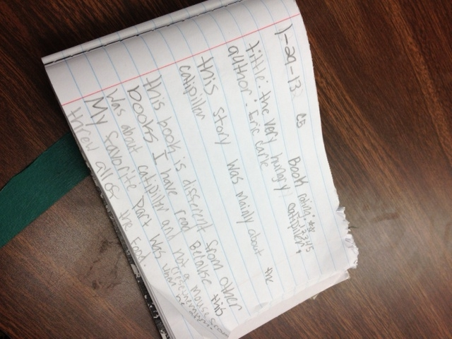

Slide 14
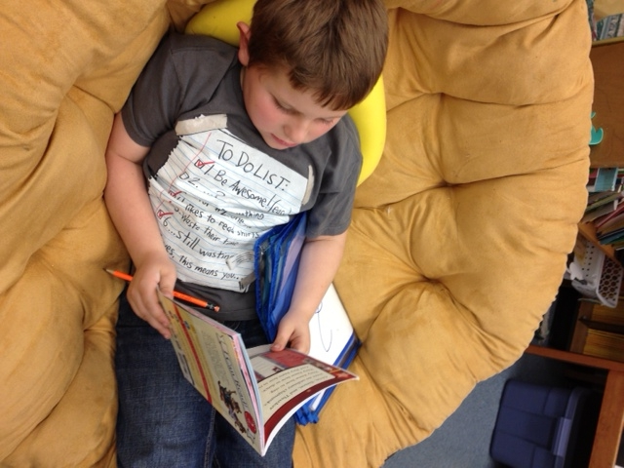

Slide 15
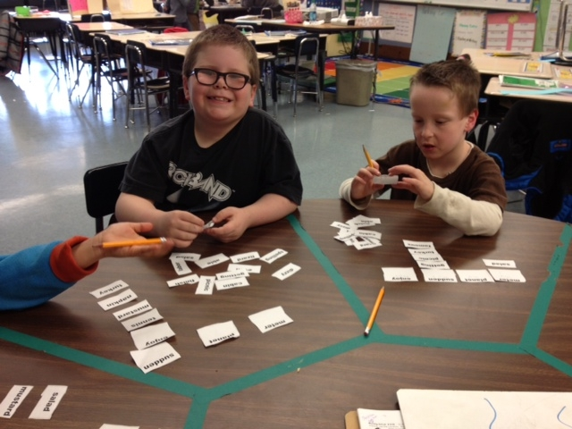

Slide 17
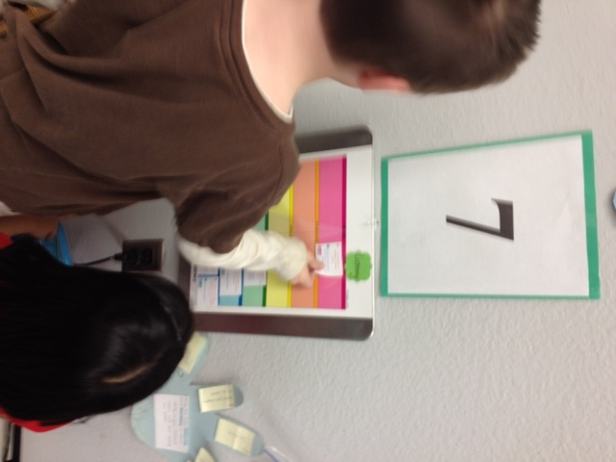

Slide 18
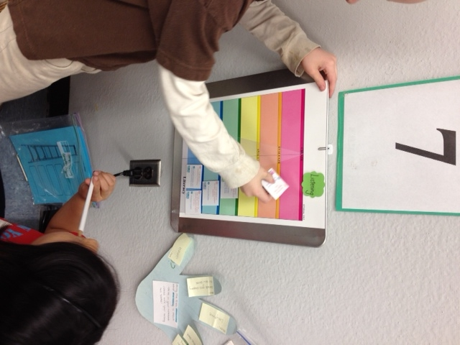

Slide 19
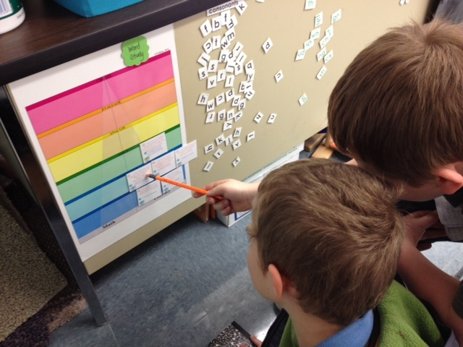

Slide 20
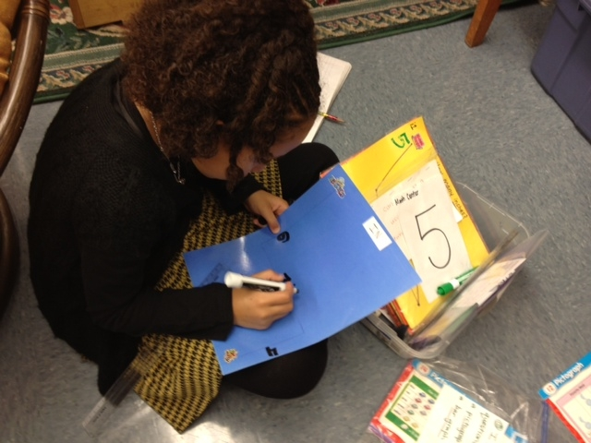

Slide 21
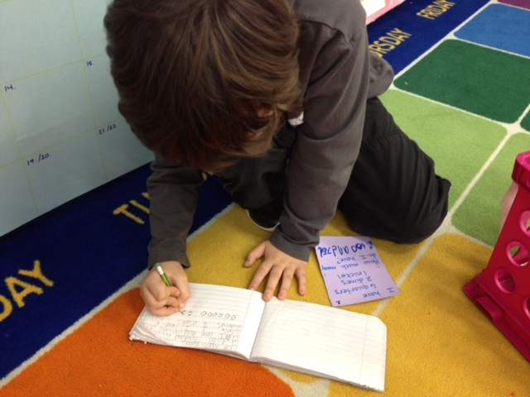

Slide 22
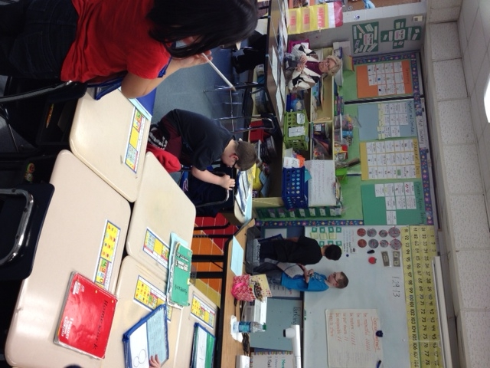

Slide 23
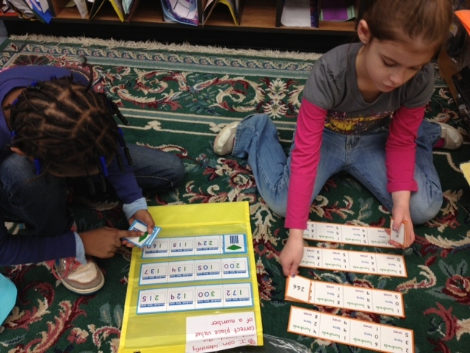

Slide 24
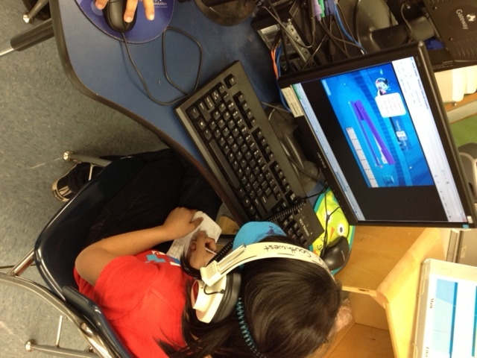

Slide 25
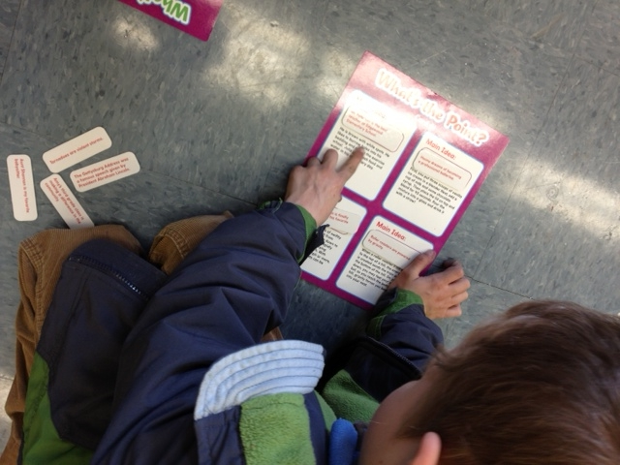

Slide 26
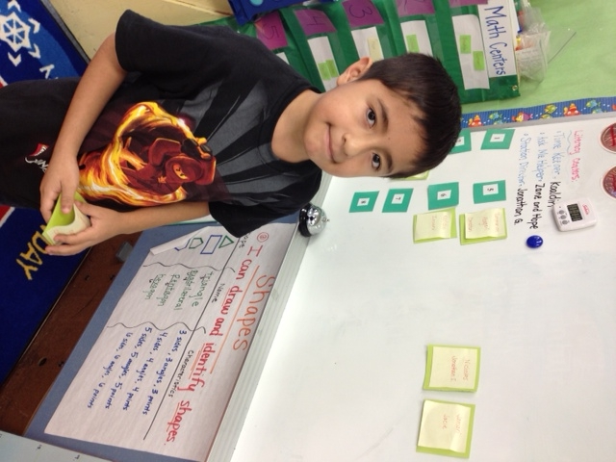

Slide 27
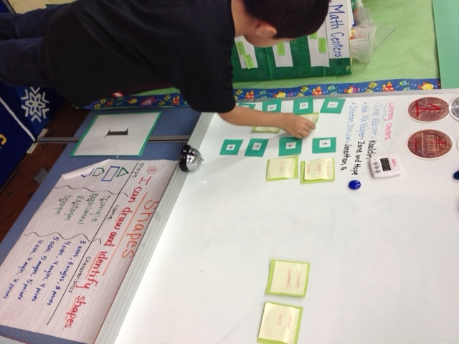

Slide 28
Leveraging District Leadership for Instructional Shifts: Collaborative Walkthroughs
Dr. Denise Patterson, Chief Academic Officer
Jennifer Griffin, Curriculum Specialist
Bobbi Siefert, Curriculum Specialist
Hickory City Schools
Notes:
DP: Welcome. Introduce us, 9 schools, 5 Elem, 2 Middle, One traditional high school and one magnet high school.
4,391 students, Title I district
Because of our size, we have seen great benefits of collaborative walkthroughs and think they have been successful

Slide 29
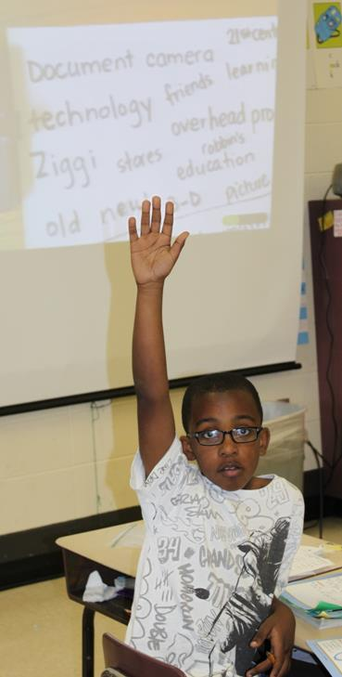
Show of Hands:
How many of you practice instructional walkthroughs in your school or district?
Notes:
JG: APK
My name is Jennifer Griffin, I am a NBCT with a background in middle school. I taught everything but math. I have a master’s degree in Curriculum, and I have been with HPS for 6 years. Help us to get to know you a little bit with a show of hands. How many of you practice instructional walkthroughs in your school or district? This is a quick formative, so we can know who is starting with walkthroughs vs who is refining a process already in place.

Slide 30
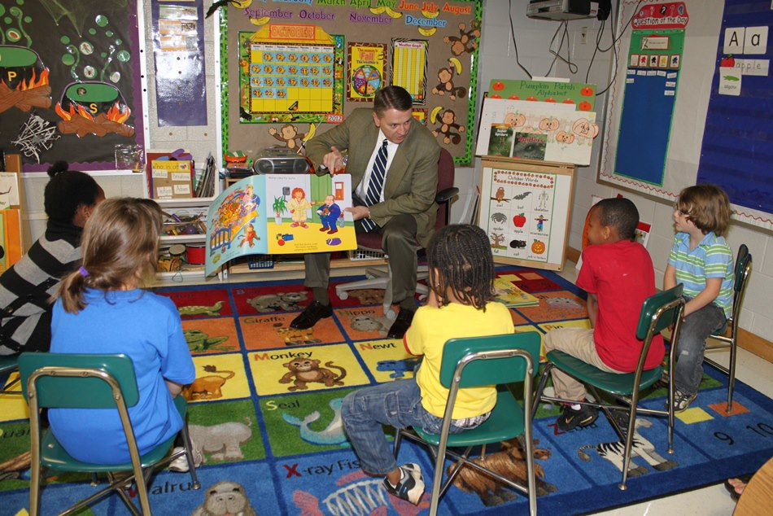
Fist to Five:
How impactful are walkthroughs in an effort to improve instruction?
Notes:
JG: Fist to Five
For those of you who currently have wallkthroughs in place, fist to five, five being most effective and one being ineffective, how impactful are walkthroughs in an effort to improve instruction?

Slide 31
Traditional Classroom Walkthroughs
Are walkthroughs completed in isolation?
Does the data collected align with district initiatives?
Does the data impact instruction?
Notes:
Our district started using a packaged walkthrough process about 5 years ago. At that time, we trained on a tool provided by the company. We only completed walkthroughs in groups during the training. As we reflected on this process, we discovered that the info we collected no longer matched what we were emphasizing in local PD. And the data were not being utilized as we had hoped. The question became: how can we re-design walkthroughs to make them more impactful?

Slide 32
Our Initiative: Collaborative Walkthroughs
Building Instructional Capacity
Notes:
The result of the reflection was the collaborative wakthrough initiative. We revisioned the process last spring in preparation for the fall.

Slide 33
Goal:
To Leverage and Build Instructional Leadership
Alignment to new standards
Focus on student active participation and research-based instructional practices
Understanding the levels of cognition
Notes:
We had two main goals for this process. First, we wanted to grow our instructional leaders. More important than ever to have conversations about teaching and learning with new standards.
We wanted to support principals as they work to evaluate so many new curricula and observe instructional shifts necessary to align to cc and es. We wanted to focus on student actions and cognitive demands in the classroom.

Slide 34
Goal:
To Maintain Fidelity of Instructional Initiatives
PLCs
The Instructional Framework: Anatomy of a Lesson
The Relational Framework: Capturing Kids’ Hearts
Literacy Instruction
Mathematics Instruction
Notes:
Bird Story
The second goal was to give our initiatives wings! Do we see evidence of PLCs and data driven instruction. Are our teaching utilizing our instructional framework, AOL, to increase student active participation? Are we using our relational framework to build 21st century leaders and learners? Are we making the shifts with new standards in literacy and math instruction? Collaborative walkthroughs help us focus on the expectations for instruction and leverage the professional development we have invested in.

Slide 35
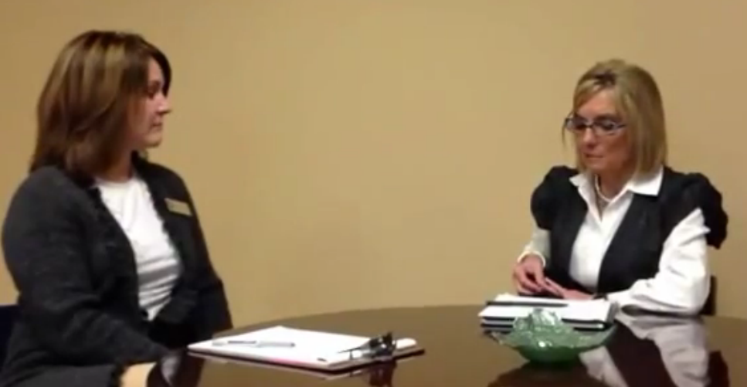
Principal’s Perspective
Click here for video
Notes:
In this short video clip, Mrs. Dischiavi, one of our fantastic middle school principals talks with Bobbi about the benefits of collaborative walkthroughs.

Slide 36
Key Components
Scheduling:
Initiated at the district level
School sites/times/teams vary each semester
Fall and Spring teams
District personnel in schools
every week
Notes:
One benefit is it pairs different personnel from across the district. In terms of scheduling, it is initiated at the district level.
We visit all the school sites at various times throughout each semester.
We assign different team members for fall and spring for varying perspectives.
Included with monthly reminders for principals to keep the emphasis on their importance. Email reminders before and feedback to teachers visited. Depending on needs that surface, we can provide additional coaching or suggest that developing teachers visit accomplished and distinguished teachers.

Slide 37
Collaborative Walkthrough Process
Levels of Instructional Walkthroughs:
Paired principals and assistant principals with district personnel
Paired literacy coaches with principals, assistant principals and district personnel
Notes:
BS: Mrs. Dischiavi summed up many of the benefits of collaborative walkthroughs.
When creating the schedule, we had to be strategic in who we placed with whom based on strengths and needs in each building.
Had to align with district personnel’s schedules and we also had to be specific about the structure.
Copies of schedules in packets. Set this up over the summer at retreat. Focus again on district initiatives on an on-going basis. Had schedule early on to prevent conflicts and help them prepare to be out of their buildings. Reminded consistently. Highlighting that it is important.

Slide 38
Elementary Principals AOL Walkthrough Schedule 2012-2013
11/9 | Oakwood/Black
11/14 | Viewmont/Willis
12/10 | Southwest/Helms
12/11 | Jenkins/Jolly
12/17 | Longview/Hodakowski
1/9 | Oakwood/Jolly
1/16 | Viewmont/Black
2/20 | Jenkins/White
2/27 | Southwest/Hodakowski
2/28 | Longview/Helms

Slide 39
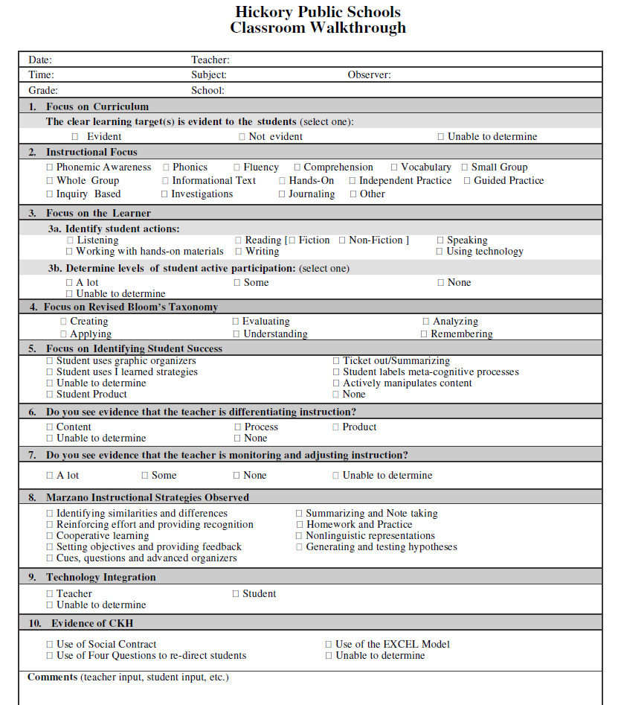
Notes:
The form is not completely different from the original form. The pieces that worked well are still there. (Marzano and levels of thinking) Evolved to also include our instructional/relational frameworks.
Key component here is we all work from same form. So for purposes of debriefing, we begin to build a common understanding and language around instructional expectations. We can record paper pencil or we have the ability to enter data into our ipads. Some principals use this time to count toward their weekly walkthrough goals. Other principals use this information to determine next steps for specific teachers.

Slide 40
Walkthrough Form
Walkthrough forms are based on district instructional non-negotiables.
Conversations are the key part of the process.
Notes:
Form we use to facilitate those instructional conversations was aligned to the instructional initiatives . Wanted to communicate consistently the importance of district initiatives.

Slide 41
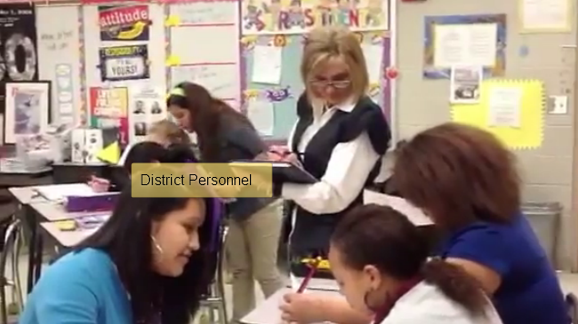
Instructional Visit
Click here for video
Notes:
In this short video clip, you will see a collaborative walkthrough in action. As you view, please note the team engages students to ask about what they are learning and use of walkthrough form. Principals schedule the classrooms we visit and are strategic in selecting the rooms we observe.

Slide 42
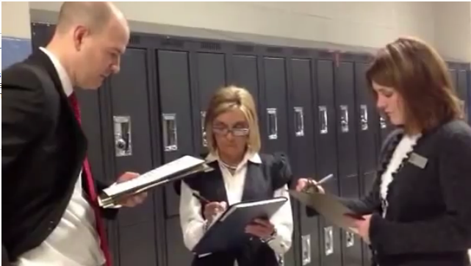
Instructional Debriefing
Click here for video
Notes:
Initiates conversations around instructional improvement
Focus on common language and expectations around district initiatives

Slide 43
Non-evaluative, but
formative and
informative!
Notes:
BS Non-evaluative means it gives feedback on areas of improvement or highlights teacher success, but does not go in North Carolina Educator Evaluation System.
Formative in that it gives principals and district personnel guidance in the types of support needed. Do we need Professional Development on classroom management? AOL? Data drives what we provide.
Informative in that it helps principals and district personnel discuss teaching and learning and what is most effective and feedback to individual teachers.

Slide 44
Curricular Vision
Resulted in an articulation of defined curricular vision
Informed mid-year check points
Aligned vision for directors, principals, assistant principals and curriculum department
Notes:
Collaborate with instructional leaders and provide assistance to teachers to continue to improve student achievement. With all the data we have received and all the changes in education, what is it that we value and expect? RBT in place, AOL, Marzano’s strategies, is the learning target visible and aligned with the curriculum? Do we see evidence of CKH?
After we articulated our vision, we met with Principals and analyed walkthrough data after we analyzed how the walkthrough data reflects each school’s success in aligning with district expectations. Who is implementing effectivelly? What can we do support better alignment to our literacy plan? How can we support the shift in common core in math classrooms? How can we leverage PLCs to improve student achievement using this walkthrough data?

Slide 45
Notes:
The form is not completely different from the original form. The pieces that worked well are still there. (Marzano and levels of thinking) Evolved to also include our instructional/relational frameworks.
Key component here is we all work from same form. So for purposes of debriefing, we begin to build a common understanding and language around instructional expectations. We can record paper pencil or we have the ability to enter data into our ipads. Some principals use this time to count toward their weekly walkthrough goals. Other principals use this information to determine next steps for specific teachers.

Slide 46
Collaborative Walkthroughs
Helps district target and differentiate professional development
BT walkthroughs
Classroom visits in other schools
Supports principals as instructional leaders in the building
Revision faculty meetings
Structure of PLCs
Notes:
After completing walkthroughs and debriefing with our team, we can see if there are needs for beginning teachers (for example) this lets us know what type of professional development to provide. So it helps us to differentiate our professional offerrings.We have a principals who is offering a refresher session on AOL. Our department responded to that need by providing the PD. The principals required the teachers who need it to attend, but opens it up for others who may want to attend.
Principals have increased their understanding of effective teaching and learning as a result of the collaboration with principals from other schools and district personnel. This is helping us address the shifts required in new standards. We are advocating for more student active participation. When you have the chance to step out of your own school and observe another set of classrooms, you can grow your own skills and strategies.
We have found that the conversations also lead to other types of collaboration. (example dress code and hallway management)
We also have more continuity and inter-rater reliability because we are discussing instruction in context with real life examples.

Slide 47
Collaborative Walkthroughs
Fosters opportunities for principal discussion on many topics
Instructional shifts
Model math classrooms
Builds inter-rater reliability, continuity and community
Common tool
More consistency reflected in NCEES
Opens the door to communicate: Principal PLC
Notes:
After completing walkthroughs and debriefing with our team, we can see if there are needs for beginning teachers (for example) this lets us know what type of professional development to provide. So it helps us to differentiate our professional offerrings.We have a principals who is offering a refresher session on AOL. Our department responded to that need by providing the PD. The principals required the teachers who need it to attend, but opens it up for others who may want to attend.
Principals have increased their understanding of effective teaching and learning as a result of the collaboration with principals from other schools and district personnel. This is helping us address the shifts required in new standards. We are advocating for more student active participation. When you have the chance to step out of your own school and observe another set of classrooms, you can grow your own skills and strategies.
We have found that the conversations also lead to other types of collaboration. (example dress code and hallway management)
We also have more continuity and inter-rater reliability because we are discussing instruction in context with real life examples.

Slide 48
We learned the importance of conversations around instructional initiatives across the district within the context of our classrooms.
Notes:
It takes a team and collaboration. Our PLC and collaborative culture.

Slide 49
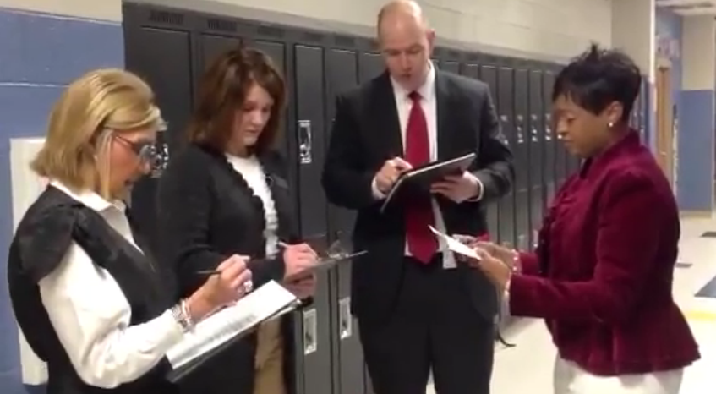
Instructional Conversations
Click here for video

Slide 50
Questions or Feedback?
Dr. Patterson
pattersonde@hickoryschools.net
Bobbi Siefert
Curriculum Specialist
siefertbo@hickoryschools.net
Jennifer Griffin
Curriculum Specialist
griffinje@hickoryschools.net
Chief Academic Officer

