Slide 1
Anatomy of a Lesson: HPS Instructional Framework
Academic Learning Time and the 21st Century Classroom
Notes:
Have a scribe take notes on vocabulary associated with AOL.

Slide 2
Academic Learning Time
Student UNDERSTANDS THE LESSON OBJECTIVE
Student ACTIVELY MANIPULATES content of lesson
Student experiences 75% - 95% SUCCESS RATE
Notes:
ALT Learning Time is what provides students the framework to “fill in the blanks” in the prior slide

Slide 3
Anatomy of a Lesson (AOL)
20%
(APK) Assess, Activate Prior Knowledge
20%
(TIP) Teacher Input
45%
(SAP) Student Active Participation
15%
(ISS) Identify Student Success
Notes:
Be sure they understand this is not necessarily a linear representation.

Slide 4
Clear Learning Targets
What should students know and be able to do at the end of the lesson?
Posted and written in student friendly “I can” language
Notes:
Best practice. Part of ALT that student understands the lesson objective.

Slide 5
Share your learning target. . .
Notes:
Example and counter example.

Slide 6
Active Prior Knowledge (APK)
Assess and build background knowledge
Prime students for learning
Link new knowledge to cognitive web
Notes:
Where we focus students for new information of techniques
Think of it as stretching or warming up before exercising
Not the same as an emotional hook. That engages the student to be excited about the content. Have that too, if you choose. The APK is more skill based and content driven than affective.

Slide 7
Assessing and Activating Prior Knowledge
Think-Pair-Share
Informal Q and A
Brain Dump
Graffiti Write
Knowledge Rating,
K-W-L
Pretest
Conga or Cooperative Learning Groups
Thumbs, Fist to Five, Speedometer
Admit Slips
Interactive Notes
Bell ringer
(APK)
Notes:
Tell why it is important. If you are teaching addition of mixed numbers, what skill is a prerequisite you would want students to remember prior to the instructional piece? If you are energy transfer through the ecosystem in science, what info would you want students to remember?

Slide 8
Teacher Input (TIP)
Communicate the content (CKH)
  Dynamic, dialogical
  Flexible
  “Real World”
Notes:
Recall from CKH:Not simply the passing along of information and material but a classroom dialogue
Relevancy: a very important task in this step is the ability to translate that which is being taught into “real world” benefits.
Students must see how their studies will benefit them in their future efforts at earning a living and finding meaning for their lives.
In this component, we’re like a good salesman. When students object to learning, we must be able to overcome their objections and convey the need for learning to take place

Slide 9
Teacher Input
Teacher Directions
Sharing Background Information
Modeling
Answering Student Questions
Reviewing
Explanation of a Concept
Monitoring and Adjusting Lesson Based on Formative Assessment
Introducing a Concept through discussion, multi-media, a visual, or an auditory experience
Frontloading Vocabulary
(TIP)
Notes:
Just a few examples of TIP. Students have opportunity to interact to process and make meaning. CLT, directions: process with a partner. A partner…B partner…

Slide 10
Student Active Participation (SAP) Empower (CKH)
“Use and do”
Develop skills
Becoming
Who is doing the work in the class?
“When you do for people what they can and should do for themselves, you stifle their confidence.”
                -Bethany Rosebrock
Notes:
Students learn information or a technique in the communication step and then practice and apply what they’ve learned until it becomes a knowledge or a skill
Teachers see their students in terms of what they are becoming, they see themselves as the resource to help their students become.
Empowerment occurs when students gain the ability to “use and do” what they’ve been taught

Slide 12
Student Active Participation
Cooperative Learning Groups
Manipulating Content
Creating their own…
Structure and Choice
Student DOING…
Making content relevant
Teacher as facilitator, coach, and advocate
Engaged vs. Well Managed
Connecting content to…
(SAP)
Notes:
A few examples of SAP. Who is doing the work in the class?

Slide 13
Brainstorm SAP

Slide 14
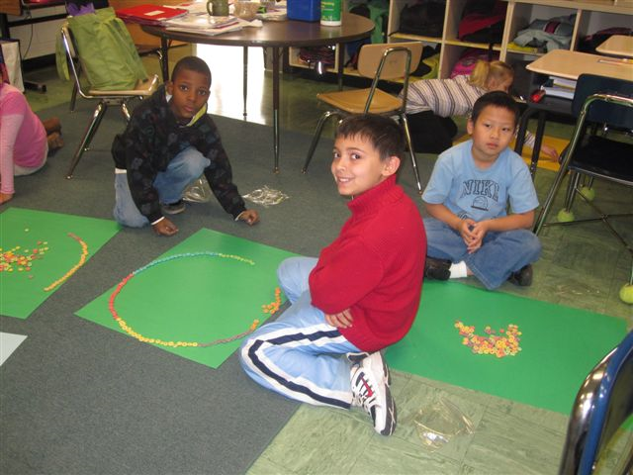
Manipulating Content through Creating Physical Representations

Slide 15
Manipulating the Content Using 21st Century Tools
Notes:
Not necessarily “PC,” but this student “gets it.”

Slide 16
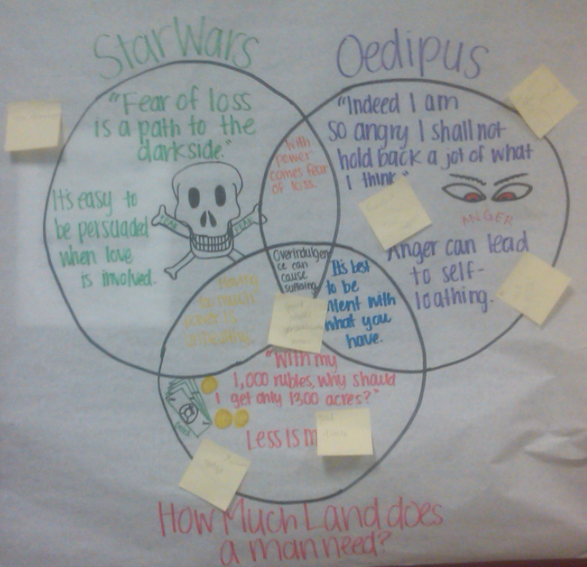
Manipulating the Content by Creating Connections
Notes:
An example from HHS.

Slide 17
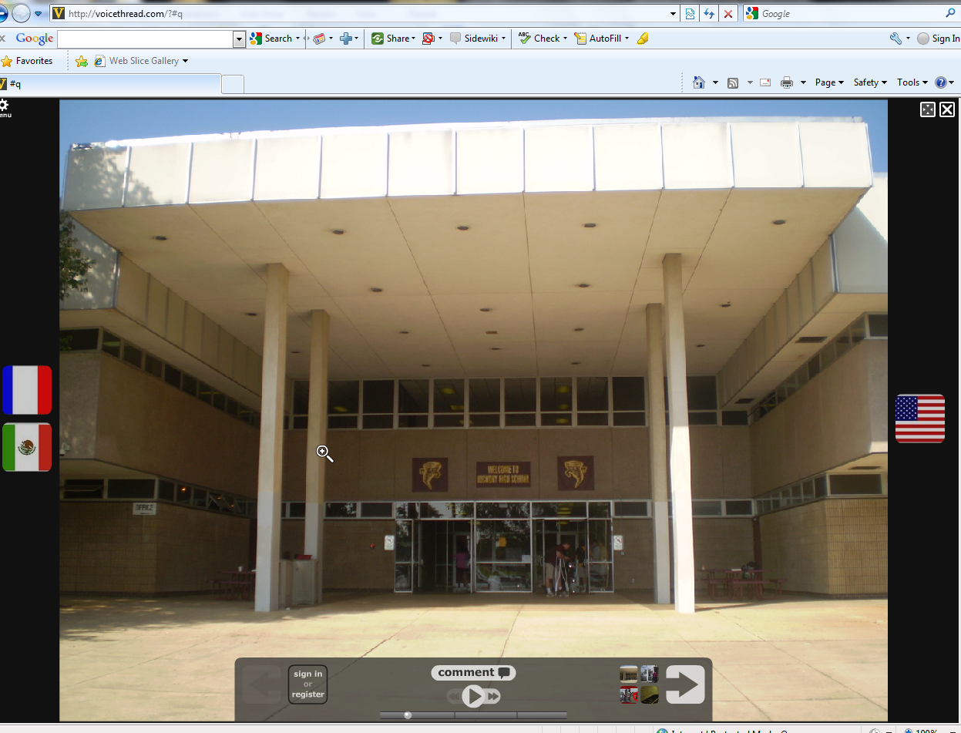
Manipulating the Content through Relevant Creation
Notes:
Students created a series of voicethreads about HHS procedures in German, Spanish, and French. (And English) This helped some of our students who may be new to the school and from different cultures.

Slide 18
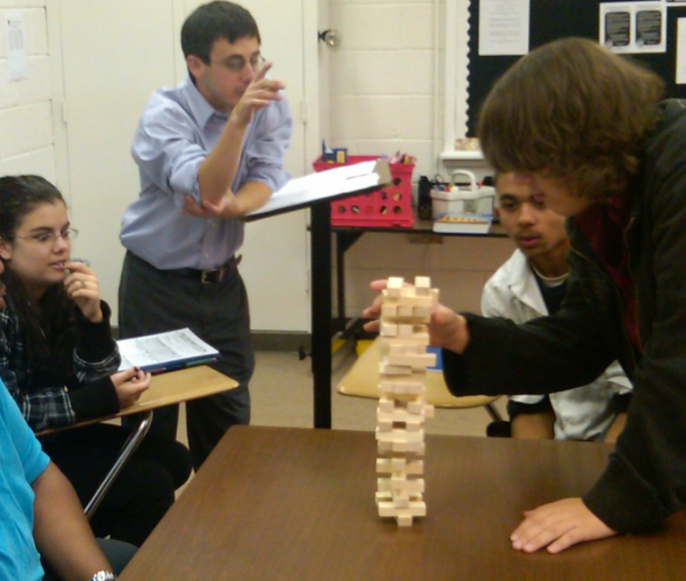
Manipulating the Content through Competition

Slide 19
Jigsaw/Cooperative Groups
Hitler’s Rise
Concentration Camps
Britain’s Role
Soviet Union’s Contribution
Japan’s Entry
Atom Bomb Development
STEVEN
Tayden
PEDRO
MELODY
ASHANTI
TYRONE
Notes:
This "cooperation by design" facilitates interaction among all students in the class, leading them to value each other as contributors to their common task.

Slide 20
Teacher’s Role
Important piece of the puzzle
Actively coaching and guiding students toward answers
Soliciting the “expert” information
Moving from group to group
Being a constant, visible resource at all times

Slide 21
Expert Groups
Teacher MUST have a detailed, structured plan that does NOT overwhelm students.
Teacher may even provide specific questions to be answered by the group.
  Textbook
  Handouts
  Web resources
  Video set up
  Graphic Organizers

Slide 22
Identifying Student Success = Informal Formative Assessment
Quick strategies – seamless with instruction
Directly related to learning goals/targets
Feedback to adjust instruction
Informs next instructional steps
Notes:
In terms of daily instruction

Slide 23
Resource For ISS
http://rt3region7.ncdpi.wikispaces.net/Formative+Assessment+Strategies

Slide 24
Self-Assessment
On a scale of 1-5, where are you with AOL implementation?
What do you need to support the instructional shift to include 45% SAP in a class period?

